Slide 1

Financial Transaction Data Analysis
Key Insights and Spending Behavior Trends

Slide 2
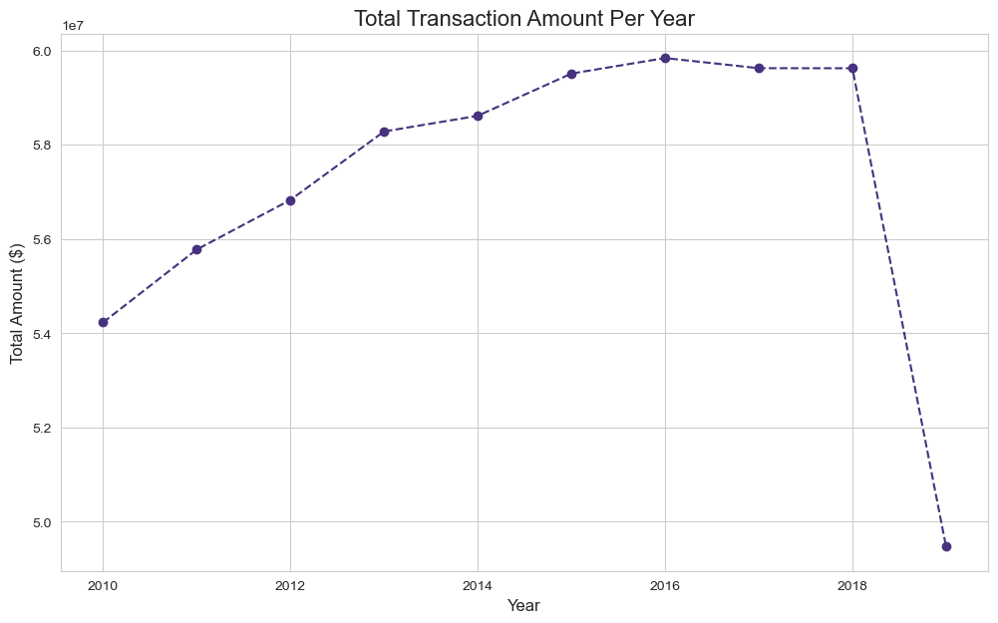
Overview of Total Annual Transactions
- The chart shows steady growth in total spending volume from 2010 until it peaked between 2016 and 2018.
- There is a sharp and sudden drop in total spending in 2019.
- Key Insight: There's healthy spending growth over the decade, but the 2019 drop requires deeper investigation to understand its causes (e.g., incomplete data, market condition changes, or a shift in consumer behavior).

Slide 3
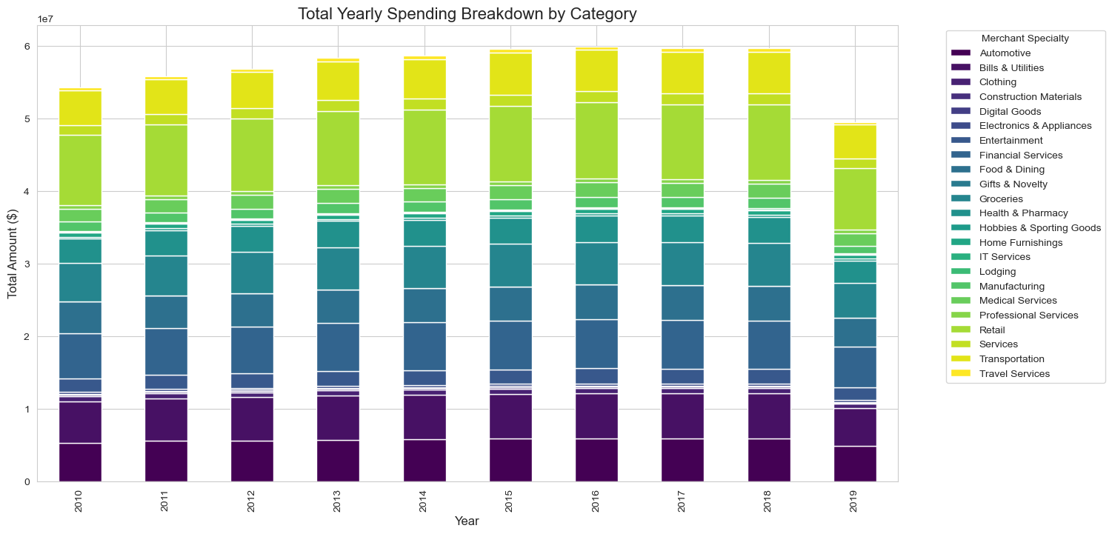
Annual Spending Breakdown by Category
- This stacked bar chart shows the spending distribution across different categories each year.
- Certain categories like 'Retail', 'Professional Services', and 'Bills & Utilities' consistently account for a large portion of total spending.
- Key Insight: The most significant consumer categories can be identified, helping to direct marketing strategies and offers toward these vital sectors.

Slide 4
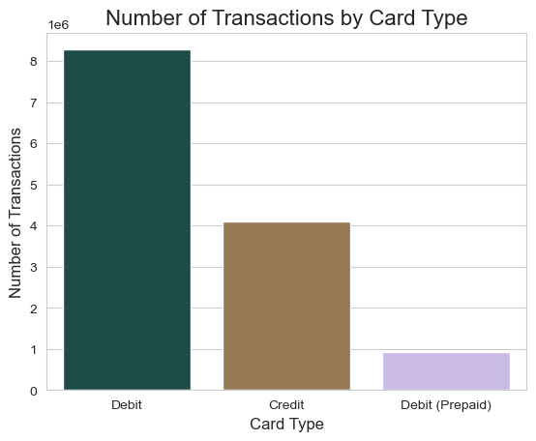
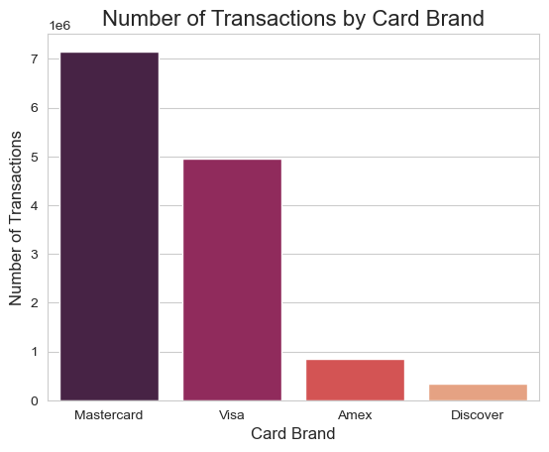
Card Types and Brands in Use
- Card Type: Debit cards are used far more frequently than Credit and Prepaid cards.
- Card Brand: Mastercard and Visa are the dominant brands in the market.
- Key Insight: Customers prefer to spend directly from their accounts rather than using credit. Marketing efforts and partnerships should focus on Mastercard and Visa debit cardholders.

Slide 5
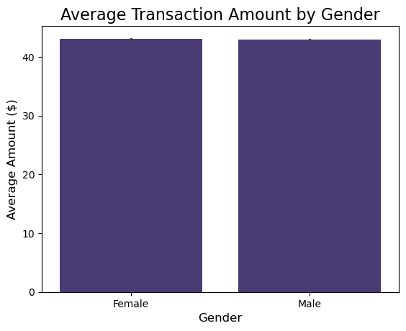
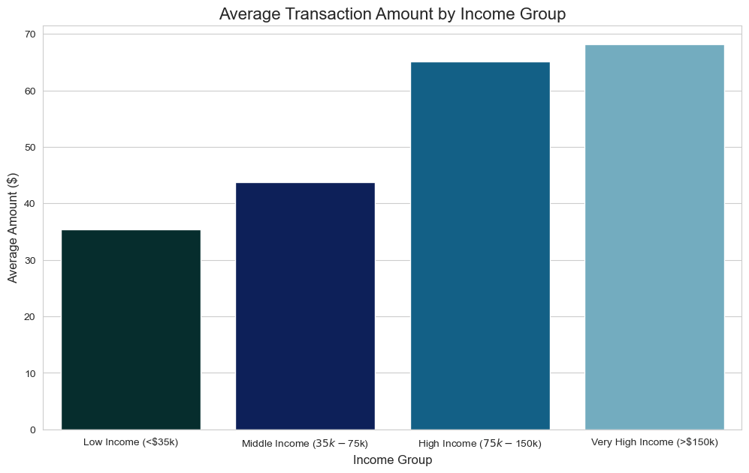
Spending Analysis by Demographics (Income and Gender)
- Income: There is a very strong positive correlation between income level and average transaction amount. The higher the income, the higher the average spend per transaction.
- Gender: There is no significant difference in the average transaction amount between males and females.
- Key Insight: Income level is the primary driver of spending volume, while gender is not an influential factor. Products and services can be tailored to different income brackets.

Slide 6
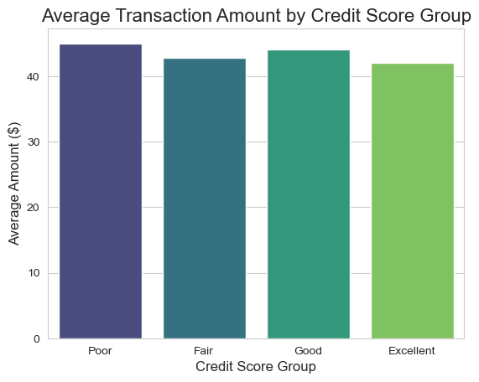
Impact of Credit Score on Spending
- Unexpectedly, the average transaction amount is very similar across all credit score groups (Poor, Fair, Good, Excellent).
- The 'Poor' credit score group has a slightly higher average spend.
- Key Insight: Credit score does not significantly impact the average value of individual transactions. This might indicate that those with lower credit scores make larger but less frequent transactions.

Slide 7
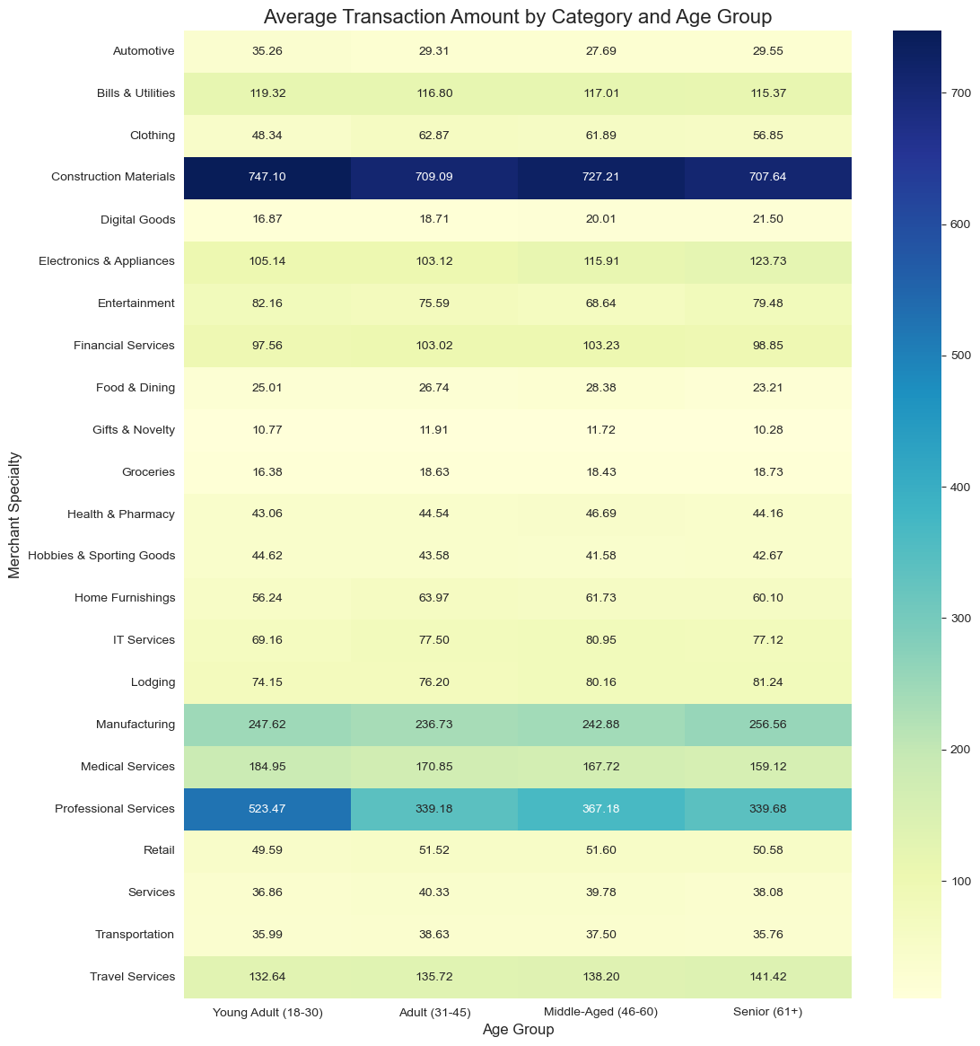
Spending Breakdown by Category and Age
- The heatmap shows that 'Construction Materials' and 'Professional Services' have the highest average spend across all age groups.
- Different spending patterns are noticeable; for example, spending on 'Electronics & Appliances' increases with the Senior (61+) age group.
- Key Insight: There are high-value spending categories that target all ages, while other categories can be tailored to specific age segments.

Slide 8
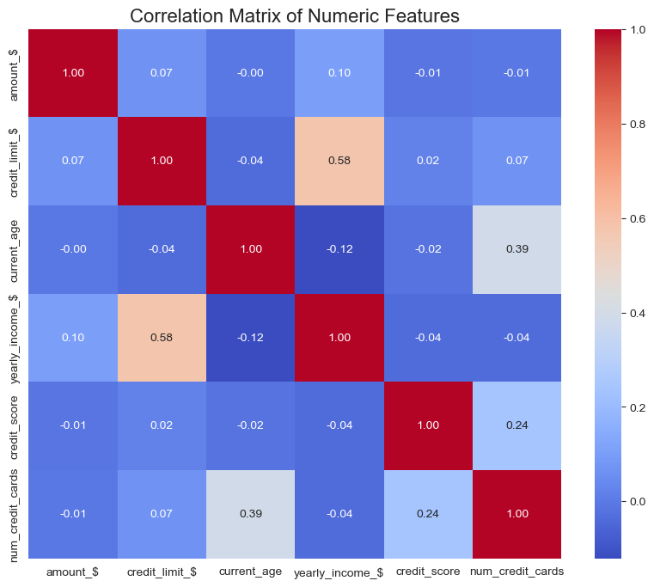
Correlation Matrix of Numeric Features
- Strongest Positive Correlation: Between 'Yearly Income' and 'Credit Limit' (0.58), which is logical.
- Other Positive Correlation: Between 'Current Age' and 'Number of Credit Cards' (0.39), suggesting older individuals tend to have more cards.
- Key Insight: The matrix confirms logical relationships between financial variables and reveals no strong, unexpected correlations.

Slide 9


Slide 10
Conclusion and Recommendations
Summary of Key Insights:
- Growth then Decline: Spending saw strong growth for 8 years followed by a sudden drop in 2019.
- Debit Dominance: Debit cards (Mastercard and Visa) are the preferred transaction tool.
- Income is King: Income level is the most impactful factor on transaction value.
- Major Spending Categories: The highest-value transactions are concentrated in specific categories like 'Construction Materials' and 'Professional Services'.
Proposed Recommendations:
- Investigate: Study the reasons for the 2019 spending decline.
- Focus: Target debit cardholders with tailored marketing campaigns and offers.
- Customize: Develop packages and products aimed at different income brackets.
- Partnerships: Build strategic partnerships with companies in major spending sectors (e.g., construction, professional services).

